Slide 1

Deep Learning Techniques for Forecasting Electrical Loads
Presented By:- Tolulope Olugbenga

Slide 2
Introduction
Load forecasting is an important part of electric utility design, planning, and operation, and it has a long history in the power industry.
A critical goal of load forecasting is to ensure that consumers receive an adequate supply of energy in order to maintain supply-demand balance.
While both statistical and machine learning (ML) techniques have been used to forecast load, machine learning algorithms are more intelligent and capable of more accurately forecasting load.
Deep learning techniques have grown in popularity in recent years due to their ability to interpret complex relationships in data more accurately.
The goal of this research was to compare deep learning forecasting techniques to some conventional forecasting techniques currently used by various utilities to see if deep learning can better meet their needs.

Slide 3
Factors That Affect the Load Demand
These factors are divided into five categories: historical load, economic load, chronological load, meteorological load, and random load.
Economic factors include capital expenditure in the facility's infrastructure, such as the construction of new buildings, laboratories, and experiments that increase the load on the electric grid.
Economic factors have little impact on short-term load forecasting because they typically affect consumption patterns over a longer period.
Because time influences how electricity is used, calendar data is used to incorporate it into load forecast models. Variables such as the hour of the day, the day of the week, the month, and the week number are used to account for these patterns.
Temperature is the most used and significant weather variable. Most load forecasting models include one or more temperature-related variables. Temperature and load have a non-linear relationship.
Random factors affecting the electrical load profile are other random disruptions in the load pattern that cannot be described by the preceding factors.

Slide 4
Peak Load Demand
The maximum amount of energy that a consumer can draw from the grid during a given time period is referred to as peak load.
A peak is distinguished from a spike by the fact that a value is considered a peak if it persists for at least 15 minutes; values that persist for less than 15 minutes are considered random spikes.
Because our three datasets were sampled using aggregated hourly load demand values, we can assume that none of them contain spikes.
Peaks are classified based on their magnitude, location in time, and width or duration. The peak's temporal location is the most important feature of all, even more important than the peak's value.
In this study, we looked at daily peaks, taking into account the peak's value and time of occurrence.

Slide 5
Load Forecasting Horizons
Electricity demand can be measured hourly, daily, weekly, monthly, or yearly, and forecasting can be done on a variety of time scales: very short-term load forecasting (VSTLF, 1-day), short-term load forecasting (STLF, 2-weeks), medium-term load forecasting (MTLF 3-years), and long-term load forecasting (LTLF >3years).
Most recent research has concentrated on short-term forecasting with time horizons of less than two weeks; it is critical in planning, contingency analysis, load flow assessment, and power system planning and maintenance.
According to Hippert, forecasting short-term load becomes more difficult when the load at a given hour is dependent not only on the load at the previous hour, but also on the load at the same hour on previous days and the load at the same hour on the same denomination day in the previous week.

Slide 6
The Benchmark Techniques – Seasonal Naïve Forecaster
The naive forecaster is a simple forecaster based on a random walk model; it is frequently used as a starting point for developing more sophisticated forecasters.
It is used to demonstrate how much value forecasters add in comparison – if a simple naive forecaster outperforms a more complex forecasting model, we know that the complex model adds little value.
According to Bracale et al., "the simplest method to anticipate the next value in a time series is to assume it will have the same values as the current value," which serves as the foundation for the naive forecaster.
The Seasonal Nave Forecaster (SNF) enhances the naïve forecaster by taking seasonal trends into account.
The naive formula uses the most recent observed value as the future value, whereas the seasonal naive formula uses the previous season's value.

Slide 7
The Benchmark Techniques – Seasonal Naïve Forecaster
The SNF can be expressed mathematically using the simple relationship shown below.
We used the previous week's lag for the SNF forecaster in this work.
The SNF forecaster is ideal for making short-term forecasts of variables that are generally stable or vary in a consistent manner.
It is, however, ineffective at forecasting time series data that fluctuate significantly or are susceptible to irregular elements such as temperature.

Slide 8
The Benchmark Techniques – Multiple Linear Regression
Multiple linear regression (MLR) is a popular statistical technique for forecasting load.
The relationships between a continuous dependent variable and one or more independent variables are modeled by MLR forecasters.
Mathematically, an MLR with two independent variables is expressed as:
The accuracy of MLRs is primarily determined by the relationships between the data and the independent variables included.
Increasing the number of relevant independent variables improves predictive accuracy in general, but the improvement eventually becomes negligible.
MLRs can simulate non-linear relationships but only with explicit user specifications.
Furthermore, MLRs are incapable of learning and adapting intelligently to data changes caused by newer factors.

Slide 9
The Benchmark Techniques – ARIMA Forecaster
Box and Jenkins developed the autoregressive integrated moving average (ARIMA) forecaster in 1970. As a result, it's also known as the Box-Jenkins model.
The ARIMA forecaster is arguably one of the most well-known and widely used statistical forecasting techniques for load forecasting.
This technique family, as the name implies, is made up of three main components: a) a "autoregression" portion that models the series' relationship with its past values (lagged values);
b) a "moving average" portion that models the forecast as a function of past forecast errors (lagged forecast errors); and c) a "integrated" portion that makes the series stationary.
To denote the ARIMA model type, specific integer values are assigned to the parameters. The ARIMA model is denoted by ARIMA (p, d, q).

Slide 10
The Benchmark Techniques – ARIMA Forecaster
The ARIMA model is heavily reliant on historical data quality and data differencing.
Time-series data that has been stabilized by subtracting the observations from the prior values is referred to as stationary data. Differencing is required because linear regression models work best with stationary signals.
The result is an estimate based on a linear combination of weighted differentiated lagged values and lagged errors, as shown in the following equation:
While ARIMA models can be accurate and reliable under the right conditions and with enough data, one of the model's main drawbacks is that the parameters (p, d, q) must be manually set.
Finding the best parameters can be a time-consuming trial-and-error process.

Slide 11
The Benchmark Techniques – ANNSTLF Forecaster
An artificial neural network (ANN) is a computer program that attempts to replicate the network of neurons found in the human brain.
The multilayer perceptron (MLP) is a well-known and widely used type of artificial neural network.
It's a feed-forward network architecture made up of one or more hidden layers of linked neurons.
The popularity of neural networks stems from their ability to discover complex and non-linear correlations in historical data, which is extremely difficult to achieve using statistical techniques.

Slide 12
The Benchmark Techniques – ANNSTLF Forecaster
The ANNSTLF is one of the most widely used machine learning-based load forecasters.
The ANNSTLF-G3 has improved prediction accuracy while also generating economic benefits for several utilities.
According to some publications, the best short-term forecaster is ANNSTLF.
The third-generation design will be used, which combines two shallow multi-layer feed-forward ANNs with a recursive least squares (RLS) combiner.
The base-load forecaster (BLF) is trained to predict regular next-day load, whereas the change-load forecaster (CLF) is trained to predict changes in load demand from day to day.

Slide 13
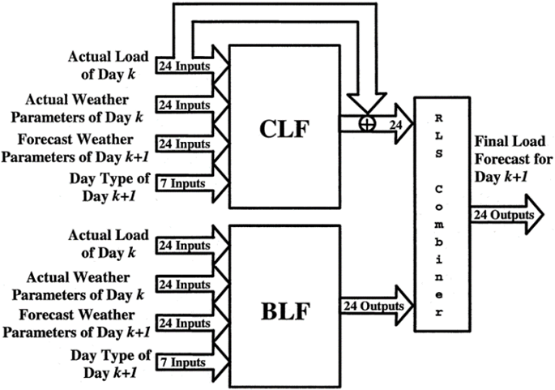
The Benchmark Techniques – ANNSTLF Forecaster
The CLF produces its final output by combining predicted changes with actual last-day values.
The BLF tends to respond slowly to sudden changes in load.
Conversely, the CLF responds to changing conditions more quickly because it uses yesterday's load as a baseline and forecasts future changes in that load.

Slide 14
Deep Learning Techniques
Deep learning is a subfield of computer science that allows computer models to learn to represent data at various levels of abstraction.
Deep learning refers to the process of increasing the depth of a network in order to reduce generalization error, rather than simply increasing the size of a single hidden layer.
Deep learning models have gained traction in fields such as computer vision, speech recognition, machine translation, and board game programming, where they have shown performance comparable to, if not exceeding, that of expert humans.
The most common deep learning techniques are deep neural networks, recurrent neural networks, long short-term memory networks, deep belief networks, and convolutional neural networks.
Deep learning and neural networks are frequently used interchangeably in discussions.
A deep learning technique is a neural network with more than three layers.

Slide 15
Deep Learning Techniques
Deep learning approaches have been shown to outperform a variety of benchmark models, including simple ANNs and standard statistical time series methods such as ARIMA, in load forecasting applications.
Deep learning models are expected to dominate the load forecasting field as computational power, datasets, and data granularity improve.
Deep learning methods such as the recurrent neural network (RNN), long-short-term memory network (LSTM), and 1-D convolution neural network (CNN) have piqued the interest of researchers in this field.
This is primarily due to their ability to learn about temporal dependencies in data inputs and to quickly adapt to sudden changes in load patterns as they occur.

Slide 16
Deep Learning Techniques – Long Short-Term Memory (LSTM)
Recurrent Neural Networks (RNNs) introduced memory into neural networks, which aids in the modeling of sequential data.
The LSTM is an RNN designed to solve vanishing gradient problems and store data for long periods of time.
The most well-known deep learning architecture for time series forecasting is LSTM, which is designed to remember past data in order to retrieve it at a suitable time in the future to produce the output prediction.
LSTMs are a type of recurrent neural network that can learn the order of dependencies between sequence elements.
Munem et al. contend that the memory cell configuration of LSTM makes it superior to other deep neural networks.

Slide 17
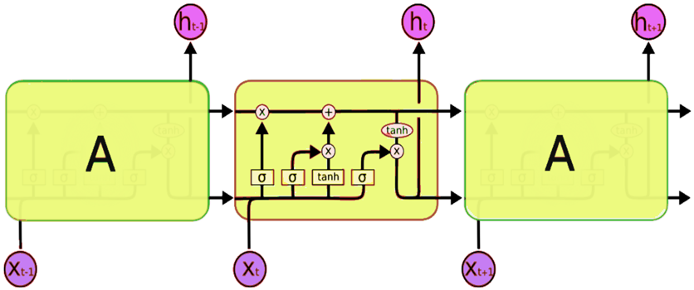
Deep Learning Techniques – Long Short-Term Memory (LSTM)
The LSTMs can remove or add information to the cell state by properly regulating gates.
In an LSTM, three gates protect and govern the cell state.
The first stage is for a sigmoid layer known as the "forget gate layer" to decide what information should be discarded from the cell state.
The old cell state is then multiplied by forgetting the items and adding the new candidate's values to update the old cell state into the new cell state.

Slide 18
Deep Learning Techniques – Long Short-Term Memory (LSTM)
To begin, a sigmoid layer executes outputs based on the cell state.
The cell state is then passed through tanh and multiplied by the output of the sigmoid gate to output only the sections we want.
If the input gate value is small and close to zero, there will be no improvement in state cell memory.
Because of the technique of forgetting and remembering information within a cell, LSTM is ideal for dealing with sequential data.

Slide 19
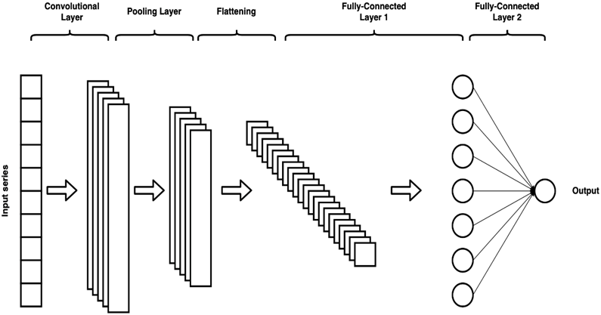
Deep Learning Techniques – Convolutional Neural Networks (CNNs)
CNNs are a type of deep learning network with a grid-like topology that is used for data processing.
This can include time series and image data, which can be represented as one-dimensional and two-dimensional data grids, respectively.
CNNs are known to boost the power of the ANN in load forecasting because they have deeper layers and model parameters such as receptive field length and dilation, which can help interpret load data better.
CNNs perform convolution by repeatedly applying filters or kernels to input data to create a feature map.

Slide 20
Deep Learning Techniques – Convolutional Neural Networks (CNNs)
The CNN may repeat the convolution process in each network's convolution layers multiple times.
The ReLU activation function, like the sigmoid activation functions, squashes the inputs, clamping negative values to zero.
In the third stage, a pooling procedure is used to smooth and minimize the dimensions of the resulting feature map.
The max-pooling method is commonly used; it returns an array of the maximum output values within the rectangle neighborhood of the previous layer.

Slide 21
Deep Learning Techniques – Convolutional Neural Networks (CNNs)
Pooling layers is a technique for reducing the size of the previous layer's output.
As a result, the subsequent layer processes fewer inputs, resulting in increased computing efficiency.
The CNN network may contain one or more convolutional layers.
The outputs of the convolutional layers are received by the hidden or fully connected layers after they have been generated.
The output layer follows the hidden layer and serves the same function as an output layer in a typical neural network.

Slide 22
The Myth of the One-Size-Fits-All Technique
Tao Hong discussed the myth of discovering the best technique
He concluded that it is critical that researchers and users understand that there is no such thing as a universally best technique.
The approach to load forecasting should be determined by the forecasting requirements and the dataset being analyzed.
One approach is unlikely to be useful in all load forecasting scenarios. With different datasets, different algorithms perform better or worse.
Furthermore, forecast errors vary significantly across utilities, utility zones, time horizons, and so on.

Slide 23
Performance Metrics
This study compares the performance of all forecasters across all datasets, considering overall performance as well as hourly, daily, monthly, and seasonal performance.
We used the Root Mean Square Error to account for severe, unusual errors (RMSE).
The MAPE and RMSE were the primary focus of this study because they are the most used metrics for load forecasting.
Because there are no values very close to zero in our datasets, the MAPE's limitations do not apply, and the RMSE allows us to detect large forecast errors.
We examined daily peak accuracy using the MAPE, MAE, and MBE metrics.
In my thesis appendix, I provided data on the overall performance of all metrics, including the ones mentioned above.

Slide 24
Investigation
The goal of this study was to see if deep learning approaches could improve forecasting accuracy for specific data sets by comparing deep learning forecasters to some of the current forecasters used by utilities.
STLF horizons were the focus of the work because they are an important tool in the day-to-day operations and planning of a utility system.
To do so, a CNN forecaster and an LSTM forecaster were pitted against four benchmark forecasters: an SNF, an MLR forecaster, an ARIMA forecaster, and an ANN forecaster.
For many years, these benchmark algorithms have been available and have been implemented and used by researchers and utilities.
The overall accuracy and peak detection accuracy were compared.

Slide 25

Datasets
Two sets are from an Independent Electrical System Operator in Ontario and have been included because the data is publicly available, which aids in reproducibility.
One set is from Ottawa, and the other is from Toronto, and they both consist of hourly city-wide load aggregation measurements from 2010 to 2019.
Both the Toronto and Ottawa datasets have a training period of 2010-2018, while the testing period is 2019.
Saint john Energy, a municipally owned utility reseller, provides the third set.

Slide 26
Datasets
Saint John Energy's data set is smaller than the others, spanning approximately 3.75 years from 2018 to October 20, 2021, but otherwise corresponds to hourly measurements of Saint John's load aggregates.
The Saint John dataset's training period is from 2018 to October 20th, 2020, and the testing period is from October 21st, 2020, to October 20th, 2021.
Weather data (temperature) obtained from Environment Canada will be used to supplement the time-series data in this work.

Slide 27
Dataset - Preparation
A Hampel filter was used to find and replace outliers in the datasets.
The filter determines the median and standard deviation for each window.
If a point in the window deviates from the median by more than three standard deviations, the Hampel filter flags it as an outlier and replaces it with the window median.
Prior to passing them to the algorithms, we normalized the variables in our datasets by using the dataset's maximum and minimum values.
Before any performance metrics were calculated, the minimum and maximum values were saved and used to de-normalize the final forecasts.
This normalization technique has been used by numerous researchers in the field of load forecasting.

Slide 28
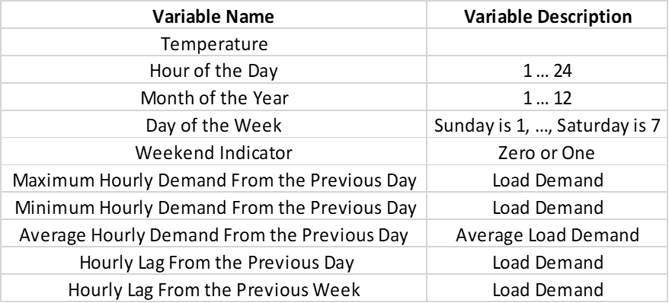
Implementation Specifications – Benchmark - SNF / MLR
We used the previous week's hourly lag as the current hour's value in the seasonal naive method, which was simple to implement.
We also repeated the previous step for each hour of our test set.
The MLR forecaster was created by combining ten independent variables, also known as inputs, and one target variable, which is the actual demand at a given hour.
The independent variables can be found at the right of the screen.

Slide 29
Implementation Specifications – Benchmark - ARIMA
The following hyperparameters were used in the ARIMA model for the Toronto, Ottawa, and Saint John datasets, respectively: (24, 2, 25), (23, 2, 24), and (24, 2, 25).
We were able to determine p and q after much trial and error and using information from the partial autocorrelation and autocorrelation functions.
Finding the optimal number of differencing 'd' needed was relatively simple; we simply used the data's auto-correlation function to determine when it was under or over-differenced.
Our time series may still be under- or over-differenced at times. The first problem can be solved by adding one or more AR terms, and the second problem by adding one or more MA terms.

Slide 30
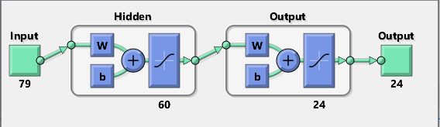
Implementation Specifications – Benchmark - ANNSTLF
The BLF and CLF networks are trained using the resilient back-propagation algorithm.
We discovered that this training method outperformed the Levenberg-Marquardt back-propagation method.
There are 60 neurons in the hidden layer.
The activation function in the hidden and output layers is a hyperbolic tangent sigmoid transfer function.
When we changed the activation function of the output layer from linear to tangent sigmoid, we saw better results.

Slide 31
Implementation Specifications – Benchmark - ANNSTLF
The training data was split into two groups, with 80% used for training and 20% used for validation.
The RLS combiner begins with a weight of 0.5 for each hour for both the BLF and CLF outputs; after each iteration, the weights for each hour are automatically updated based on the algorithm's calculation.

Slide 32
Implementation Specifications – Benchmark - ANNSTLF
The input set for ANNs consists of the following inputs on the right of this screen.
Both the BLF and the CLF used the same set of inputs, but their target variables were distinct
The BLF focused on actual load demand, whereas the CLF focused on load changes from yesterday to today.
The final CLF forecasts were calculated by adding the predicted changes to the actual load from yesterday.
The BLF and CLF used a total of 79 inputs, as illustrated in the ANNSTLF architecture.

Slide 33
Implementation Specifications – Deep Learning - LSTM
Another UNB smart-grid researcher forecasted load using the LSTM algorithm, but only on the Saint John dataset.
We changed his implementation to accept all of our datasets and feature sets as input.
We used the adam optimization training algorithm to train the LSTM models.
The LSTM network had four layers: a sequence input layer with 79 inputs, an LSTM layer with 100 hidden units, a fully connected layer with 24 outputs, and a regression layer.

Slide 34
Implementation Specifications – Deep Learning - LSTM
The amount of information kept between time steps is proportional to the number of hidden units (the hidden state).
Furthermore, because the ANNSTLF structure was identified as the best forecaster for short-term load forecasting.
We emulated it by developing a Base Load Forecaster, a Change in Load Forecaster, and an RLS combiner with the LSTM algorithm rather than the ANN.
Using the architecture yielded superior results in the long run and across multiple timeframes.

Slide 35
Implementation Specifications – Deep Learning - CNN
The CNNs in this study are composed of six layers: an input layer, a convolutional layer, a rectified linear unit activation layer (relu), a max-pooling layer, a fully connected layer, and a regression output layer.
We implemented the CNN algorithm similarly to the LSTM algorithm using the ANNSTLF structure, and as a result of using this architecture, we observed improved results overall and across all timeframes.
As was the case with the LSTM models, the CNN models were trained using the adam optimization training algorithm.

Slide 36
Method Analysis
All forecasters were built using MATLAB version R2021b.
Our goal is to forecast the load for the following day and identify daily peaks.
A quick overview of the algorithms, which use two distinct models, the BLF and the CLF, the outputs of which are then combined using an RLS combiner.
To keep things simple, only the RLS combiner results will be used in this analysis. CNN, LSTM, and ANN are the ones been referred to.
We calculated the mean absolute percentage error (MAPE) and the root mean squared error (RMSE) for the overall regular load forecasts (RMSE).
We used the mean absolute percent error (MAPE), mean absolute error (MAE), and mean biased error to determine daily peak accuracy (MBE).

Slide 37
Method Analysis
The MAPE metric was used to calculate the magnitude difference between the actual and forecasted peak values.
The time difference between the highest load aggregation occurrences in an hour was calculated using the MBE and MAE metrics.
The MAE would be used to determine the accuracy of the time difference, whereas the MBE would be used to determine the models' overall bias, whether they over or under forecast based on time of occurrence.
It's worth noting that in the tables, the MAEs and MBEs of the time difference are denoted by minutes.

Slide 38
Peak Detection Accuracy – Quick Note
In terms of peak detection accuracy, it's worth noting that daily peaks are affected by a variety of random variables, making prediction difficult.
This is because random peaks can result in significantly higher peaks than regular peaks, and because we are calculating the daily maximum, we use the random peak rather than the regular peak.
The Toronto dataset typically peaks in the evenings between 16:00 and 21:00, but as shown in the figure below, a random peak occurred at 10:00 with a value of 6594 MW, which was higher than the second highest peak at 18:00 with a value of 6590 MW.

Slide 39
Peak Detection Accuracy – Quick Note
The CNN forecasted a peak at 18:00 with a value of 6603 MW.
The random peak influences our time difference MAE and MBE accuracy metric because we will compare the predicted time to the one at 10:00.
This is just something to keep in mind when it comes to the algorithms' ability to detect peaks.
A significantly more accurate metric for comparing time differences could be used in future work.

Slide 40
Overall Performance – Toronto Dataset
The figure depicts an actual and forecasted load demand snapshot from July 17th to July 21st.
This time period was chosen because it corresponded to the month in which all algorithms performed the worst overall.
The table shows how the algorithms performed on the Toronto dataset.
The MAPE and RMSE values for the CNN were the lowest, followed by the ANN and LSTM.

Slide 41
Overall Performance – Toronto Dataset
Among all the algorithms, the CNN algorithm had the smallest error distribution.
The SNF forecaster had the worst results, with the widest error distribution and the worst global metrics.
In terms of daily peak detection accuracy, MAPE values show that the CNN is the best overall, followed by the ANN and LSTM, and finally the SNF.
According to the MAE, the CNN predicted the most accurately, followed by the LSTM, SNF, and ANN.

Slide 42
Overall Performance – Ottawa Dataset
The figure depicts an actual and forecasted load demand snapshot from July 17th to July 21st.
The table shows how the algorithms performed on the Ottawa dataset.
The overall performance of the Ottawa dataset is like that of the Toronto dataset.
The MAPE and RMSE values of the CNN are the lowest, followed by the ANN and LSTM.

Slide 43
Overall Performance – Ottawa Dataset
Among all the algorithms, the CNN algorithm had the smallest error distribution.
The SNF forecaster had the worst results, with the widest error distribution and the worst global metrics.
In terms of daily peak detection accuracy, MAPE values show that the CNN is the best overall, followed by the ANN and LSTM, and finally the SNF.
According to the MAE, the CNN predicted the most precisely, followed by the ANN and the LSTM, and finally the SNF.

Slide 44
Overall Performance – Saint John Dataset
The figure depicts an actual and forecasted load demand snapshot from December 17th to December 21st.
This time period was chosen because it corresponded to the month during which all algorithms performed the worst overall.
The table shows how the algorithms performed on the Saint John dataset.
The CNN performed best in terms of MAPE and RMSE, followed by the ANN and LSTM.

Slide 45
Overall Performance – Saint John Dataset
The SNF forecaster performed the worst overall, with the widest error distribution.
According to MAPE values, the CNN is the most accurate at detecting daily peaks, followed by the ANN and LSTM, and finally the SNF.
According to the MAE, CNN predicted the most accurately, followed by ANN, LSTM, and SNF.

Slide 46
Conclusion Based on Overall Performance
The CNN performed the best overall, based on MAPE and RMSE values across all datasets, followed by the ANN and LSTM.
Furthermore, the CNN appears to have the narrowest error distribution of any algorithm.
When the magnitudes of the peaks across all datasets are compared, the CNN has the lowest MAPE values, followed by the ANN and the LSTM, with the SNF coming in last.
CNN also had the best MAE based on the time difference between daily peaks.
In the Ottawa and Saint John datasets, the ANN and LSTM algorithms trail the CNN. The LSTM comes before the ANN in the Toronto dataset.
The results show that the CNN, LSTM, and ANN algorithms all perform extremely well.
We will look at how each of these algorithms performs on different datasets on an hourly, daily, monthly, and seasonal basis.

Slide 47
The Toronto Dataset – Hourly Performance

Slide 48
The Toronto Dataset – Hourly Performance
CNN
LSTM
ANN

Slide 49
The Toronto Dataset – Daily Performance

Slide 50
The Toronto Dataset – Daily Performance
CNN
LSTM
ANN

Slide 51
The Toronto Dataset – Monthly Performance

Slide 52
The Toronto Dataset – Monthly Performance
CNN
LSTM
ANN

Slide 53
The Toronto Dataset – Overall Seasonal Performance

Slide 54
The Ottawa Dataset – Hourly Performance

Slide 55
The Ottawa Dataset – Hourly Performance
CNN
LSTM
ANN

Slide 56
The Ottawa Dataset – Daily Performance

Slide 57
The Ottawa Dataset – Daily Performance
CNN
LSTM
ANN

Slide 58
The Ottawa Dataset – Monthly Performance

Slide 59
The Ottawa Dataset – Monthly Performance
CNN
LSTM
ANN

Slide 60
The Ottawa Dataset – Overall Seasonal Performance

Slide 61
The Saint John Dataset – Hourly Performance

Slide 62
The Saint John Dataset – Hourly Performance
CNN
LSTM
ANN

Slide 63
The Saint John Dataset – Daily Performance

Slide 64
The Saint John Dataset – Daily Performance
CNN
LSTM
ANN

Slide 65
The Saint John Dataset – Monthly Performance

Slide 66
The Saint John Dataset – Monthly Performance
ARIMA
CNN
LSTM
ANN

Slide 67
The Saint John Dataset – Overall Seasonal Performance

Slide 68
Summary
Four benchmark algorithms were compared to two deep learning techniques, CNN and LSTM.
We obtained the overall performance in terms of forecasting regular load and daily peaks.
In terms of overall accuracy, the CNN, LSTM, and ANN algorithms were the most accurate.
The performance of all algorithms was then evaluated across all datasets on hourly, daily, monthly, and seasonal predictions.
In the Toronto and Ottawa datasets, the CNN, ANN, and LSTM were ranked first, second, and third across all time periods and seasons, respectively.
In the Saint John dataset, CNN, ANN, and LSTM remained the top forecasters overall. However, the ARIMA algorithm performed better in a few cases during the winter months of January, November, and December.

Slide 69
Summary
Throughout the rest of the year, the ARIMA performed poorly. This is to be expected because different algorithms perform better or worse on different datasets or over different time periods.
Across all time periods, the CNN and LSTM performed admirably in forecasting the test datasets.
The SNF had the worst overall performance across all time periods and seasons.
The LSTM outperformed the ANN in a number of cases, and their predictions were generally quite similar.
Consider the monthly time period of the Saint John dataset as an example. The LSTM outperformed the ANN over the course of six months.
As a result, we can conclude that deep learning techniques like CNN and LSTM are useful and can help researchers and utilities improve load forecasting accuracy.

Slide 70
Contributions
Deep learning techniques are being considered due to their exceptional performance when applied to a wide range of problems.
By comparing their performance to that of conventional forecasters, the CNN and LSTM were evaluated for their added value.
We compared accuracy in terms of overall detection as well as daily peak forecasts.
This study contributes to the maturation of the ongoing debate over the use of untested deep learning methods in load forecasting.
We created algorithms that are more adaptable to external factors like annual increases in electricity demand or temperature shifts.
We created forecasters that can recognize complex data relationships without explicit user input.
We carried out analysis that was tailored to three distinct datasets.
Furthermore, because we used publicly available data for our analysis, this work will be reproducible, serving as a valuable benchmark for future research both within and outside of our smart-grid team.

Slide 71
Future Work
Several future research directions include increasing forecaster accuracy, incorporating more exogenous variables, developing more complex algorithms that are hybrids or improved models of the ones used here, forecasting the width of daily peaks, implementing more deep learning algorithms, developing separate models to forecast different days and months (e.g., summer, winter), and incorporating a holiday indicator as an input that specifies which days are holidays and when they are not.
The ARIMA forecaster's accuracy can be improved by using the SARIMAX model, which incorporates exogenous variables and seasonality.
By including additional exogenous variables, such as those used by the MLR forecaster, the performance of the ANN, CNN, and LSTM forecasters can be improved.
Depending on the analyst's goals, weather variables such as humidity, dewpoint, and wind direction/speed can be used in addition to temperature.

Slide 72
Future Work
When it comes to daily peaks, utilities benefit from knowing when and how long they will last. Determining the width of demand peaks is another approach.
Hybrid models that incorporate CNNs and LSTMs may be an option, as some researchers have observed improved performance when the two are combined.
Certain researchers have observed improved performance when separate models are created to forecast specific days, such as weekdays and weekends, or specific months, such as winter and summer.

Slide 73
Thank you for your attention ☺
Merci pour votre attention ☺

